Slide 1
Network Measurement:
Finding Group Structure in Networks

Slide 2
Approaches to discovering group structure
Why move to level of group structure rather than staying “local”?
  Like initial motivation for “role and position” analysis in sociology:
    Key idea is to get a sense of the “big picture” network structure
    Discover patterns that are not visible from a local perspective
    Simplify large scale network data into more manageable structure
Why are groups important?
  In traditional social science theory they are the “backbone” of society (Durkheim, Tonnies)
  They may reveal important underlying functional units not necessarily recognized by participants
    “Invisible colleges” in science and scientific collaboration networks
    Internal coalitions among political actors
    Latent groups in the corporate/capitalist class

Slide 3
What are “groups” or “communities”?
Graph Theory
“The Graph”
Linkage
Analogy
Matrix Algebra
“The Matrix”
Social Systems
“The Network”
Measurement

Slide 4
Some graph theoretic concepts: Subgraphs
A graph G' = (V', E') is a subgraph of a graph G iff:
  V' is a subset of V and E' is a subset of E
Subgraphs may induced by either:
  Sampling a group of vertices and the selecting the subset of edges that link them
  Sampling a group of edges and the selecting of the vertices that are the destination (origin) of each edge.
A lot of network methods are designed to split a graph into subgraphs
  Subgraphs can be used to represent the social network concepts of groups, cliques, or communities

Slide 5
What are “groups” or “communities”?
“Group,” “community,” and “cohesion” are fuzzy social science concepts, with many overlapping but sometimes contradictory verbal definitions
  As always graph theory to the rescue!
The graph theoretic concept of group/community is:
  A relative dense subgraph featuring more links among the subset of vertices that belong to the subgraph than links to vertices in the rest of the graph
Social concept: Cohesion
  Two components:
    Ideational (identification)
    Relational (connectivity)
      Graph theory is useful for specifying relational solidarity

Slide 6
What are “groups” or “communities”?
“Group,” “community,” and “cohesion” are fuzzy social science concepts, with many overlapping but sometimes contradictory verbal definitions
  As always graph theory to the rescue!
The graph theoretic concept of group/community is:
  A relative dense subgraph featuring more links among the subset of vertices that belong to the subgraph than links to vertices in the rest of the graph
In “Network Science” people jump straight to the graph theoretic concept but that’s different from the social science concept
  Various graph theoretic and matrix-algebraic ways of “finding” or “discovering” such groups in real networks (e.g. “Community detection”)
    Groups and communities may display substantively interesting variation in structure and organization

Slide 7
Some graph theoretic concepts: Subgraphs
A graph G' = (V', E') is a subgraph of a graph G iff:
  V' is a subset of V and E' is a subset of E
Subgraphs may induced by either:
  Sampling a group of vertices and the selecting the subset of edges that link them
  Sampling a group of edges and the selecting of the vertices that are the destination (origin) of each edge.
A lot of network methods are designed to split a graph into subgraphs
  Subgraphs can be used to represent the social network concepts of groups, cliques, or communities

Slide 8
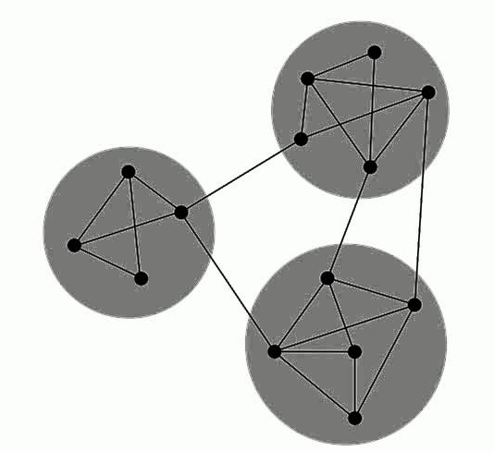
Graph connectivity
A graph is connected if there exists a (finite) path between each vertex
  Otherwise the graph is disconnected
A maximal connected subgraph is called a component
  In a graph, the connected subgraph that contains the largest proportion of vertices is called the giant component

Slide 9
Graph connectivity
A graph is connected if there exists a (finite) path between each vertex
  Otherwise the graph is disconnected
A maximal connected subgraph is called a component
  In a graph, the connected subgraph that contains the largest proportion of vertices is called the giant component
Oops! Disconnected!

Slide 10
Graph connectivity
A graph is connected if there exists a (finite) path between each vertex
  Otherwise the graph is disconnected
A maximal connected subgraph is called a component
  In a graph, the connected subgraph that contains the largest proportion of vertices is called the giant component

Slide 11
Graph connectivity
A graph is connected if there exists a (finite) path between each vertex
  Otherwise the graph is disconnected
A maximal connected subgraph is called a component
  In a graph, the connected subgraph that contains the largest proportion of vertices is called the giant component

Slide 12
Graph connectivity
Some graphs are easy to disconnect
  Only require the removal of a few links
Others are hard to disconnect
  Requires the removal of a lot of link
The number of edges whose removal is required to disconnect a graph can represent the social network concept of social integration
  This is called the cutset

Slide 13
Graph connectivity
Some graphs are easy to disconnect
  Only require the removal of a few links
Others are hard to disconnect
  Requires the removal of a lot of link
The higher the cutset the more integrated the social network
The lower the cutset the more potentially fragmented the social structure is

Slide 14
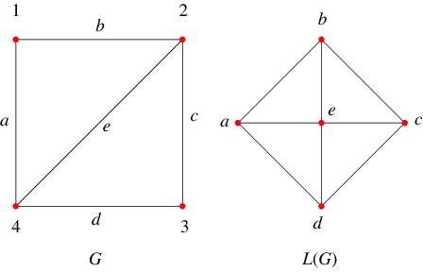
Matrix Representation: Line graphs
For any given graph G = (V, E) with N vertices and M Edges represented by adjacency matrix A of dimensions N x N:
  We may obtain the corresponding line graph (or edge graph, edge adjacency matrix) by:
    Creating a graph L(G) represented by adjacency matrix B, of dimensions M x M with:
      B_{ij} = 1 if e_{i} and e_{j} share a common vertex v_{k}
      B_{ij} = 0 if e_{i} and e_{j} do not share a common vertex

Slide 15
Approaches to discovering group structure
Hierarchical Clustering-based
  Develop indices of node-similarity and use clustering procedures on node x node distance matrix
Graph theoretic (edge-based) partitioning
  Take advantage of certain principles of graph connectivity (e.g. walks, paths, graph theoretic distance, cutsets, and cutpoints) to find optimal subgroups
Graph decomposition (e.g. “optimization”)
  Use a criterion for optimal group structure (e.g. modularity) and calculate extent to which observed graph approximates
    (e.g. in comparison to random graph of same size and order)
      Note: Some of these are graph-theoretic, some are matrix algebraic
      All involve “clustering” in some sense

Slide 16
Approaches to discovering group structure
Regardless of their basis (e.g. graph theoretic, algebraic, or other), algorithms designed to split a graph into “groups” will find “groups”
  Different algorithms produce different graph partitions
  How do you know you have succeeded in finding the “real” groups?
    Short answer: You never know!
    Long answer: Compare against independent benchmark
      Your own intuition (not very good)
      Other people’s intuition (a bit better)
      The intuitions of the people who actually belong in the network (even better)
      Some sort of network independent criterion of groupiness (probably best but hard to find)
      Use criterion validity: Does your partition predict important outcomes?

Slide 17
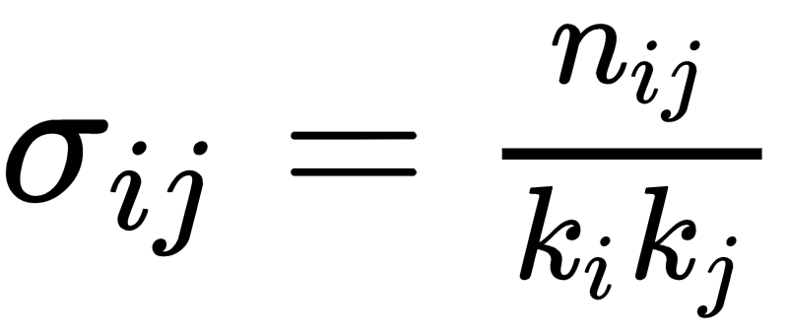
Approaches to discovering group structure
Clustering-based approaches
  Clustering as much of an art as a science
  Steps:
    Develop a criterion of similarity between nodes such that more strongly connected vertices receive higher values
      For instance cosine similarity:
      Where n_{ij} is number of common neighbors between i and j and k is degree
    Hierarchical clustering on that distance matrix will produce a partitioning of the vertices into classes

Slide 18

Approaches to discovering group structure
Clustering-based approaches
  Clustering as much of an art as a science
  Steps:
    Develop a criterion of similarity between nodes such that more strongly connected vertices receive higher values
      Could substitute others such as Euclidean distance:
      Where a_{ix} = 1 if i is connected to x
    Hierarchical clustering on that distance matrix will produce a partioning of the vertices into classes

Slide 19
Approaches to discovering group structure
Clustering-based approaches
  Clustering as much of an art as a science
  Steps:
    Develop a criterion of similarity between nodes such that more strongly connected vertices receive higher values
      Or a lot of other options:
        Correlation distance (as in CONCOR)
        Number of shared contexts or groups (in a one-mode projection)
        Graph-theoretic distance (e.g. shortest paths)
        Vertex attributes
    Hierarchical clustering on that distance matrix will produce a partitioning of the vertices into classes

Slide 20
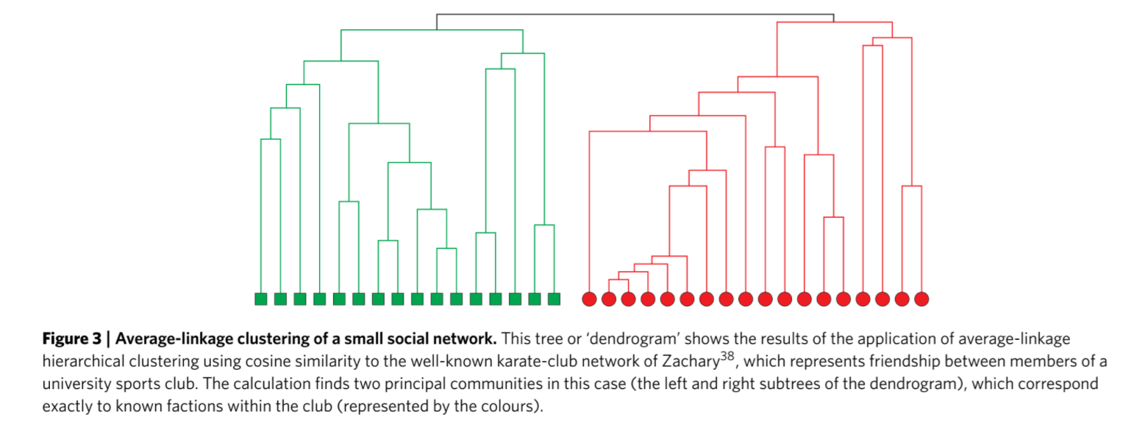
Approaches to discovering group structure

Slide 21
Approaches to discovering group structure
Hierarchical clustering approaches have many appealing properties
  They are simple
  They recover fundamental intuitions about our understanding of groups such as the fact that they are hierarchical and nested
However,
  Sensitive to initial similarity measure chosen
  Sensitive to clustering criterion used (e.g. single-linkage, complete-linkage, average, etc.)
    When in doubt go with average?
  Clustering approaches don’t know what to do with weakly connected nodes

Slide 22
Approaches to discovering group structure
Graph theoretic approaches differ from clustering approaches in focusing on properties of edges to find a partitioning in the graph:
Basic idea:
  Find the edges that are most likely to connect the whole graph
  Remove those edges
  Check to see if the network features more connected components than before
  Do the same thing within each connected component
  Check to see if the graph is partitioned into even more components
  Stop when you have reached a number of fully connected cliques (N >= 2)
    Graph theoretic approaches can be thought of as following a form of divisive clustering of the graph based on edges

Slide 23
Approaches to discovering group structure
Graph theoretic approaches differ from clustering approaches in focusing on properties of edges to find a partitioning in the graph:
Basic idea:
  For instance the Graph-Theoretic algorithm proposed by Girvan and Newman (2002) goes like this:
    Calculate betweenness scores (e.g. shortest paths, random walk, etc.) for all edges in the network
    Find the edge with the highest score and remove it from the network
    If two or more edges tie for highest score, choose one of them at random and remove that
    Recalculate betweenness for all remaining edges
      Repeat from step ii.

Slide 24
Groups and Cohesion
The Social Science Concept of Cohesion
  Cohesion implies nested groups
Operational definition
  A group is more cohesive to the extent to that it depends on a majority of members to retain it character as a group
  Less cohesive groups depend on a few individuals (at the limit one) to remain connected
Structural cohesion is simultaneously a property of
  Persons
  Groups

Slide 25
Graph Theory: Walks, Trails, Paths
A walk is an alternating sequence of vertices and edges {u₁, e₁₂, u₂, e₂₃, u₃....u_{n}} starting with an origin vertex u₁ ending with a destination vertex u_{n} such that:
  Each vertex in the sequence (excluding the origin and destination vertices) is adjacent to the vertex the precedes it and the vertex that follows it
The length of the walk is the number of edges contained in the sequence
  A walk is called a path if all edges and all vertices appear only once in the sequence
Graph-theoretic paths can be used to represent the social network concept of “n-degrees of separation” between people
  In particular, we may be interested in the length of the shortest path (L > 1) linking two people

Slide 26
Graph Theory: Walks, Trails, Paths
A walk is called a trail if all edges appear only once in the sequence (no edge is traversed more than once)
A walk is called a path if all edges and all vertices appear only once in the sequence
  All paths are trails and all trails are walks, but not every walk is a trail and not every trail is a path
  Two paths are vertex-disjoint if they share no vertices
  Two paths are edge-disjoint if they share no edges
  A geodesic (graph-theoretic distance) is the shortest-path between two distinct vertices
    May be represented as a pairwise matrix D, with D_{ij} = geodesic distance between i and j

Slide 27
Groups and Cohesion
Definition 1: A collectivity is structurally cohesive to the extent that the social relations of its members hold it together.
  Describes how a collection of actors is held together
  Group-level property
  Continuous concept (some groups are more or less cohesive)
  Depends on relational data
  Independent of size
Minimal graph theoretic requirements:
  Unconnected individuals are not cohesive
  Cohesive individuals must be connected by some path
  The most cohesive groups connect individuals via multiple paths
  The more cohesive the group, the more redundant paths between people

Slide 28
Groups and Cohesion
Definition 1: A collectivity is structurally cohesive to the extent that the social relations of its members hold it together.
  Describes how a collection of actors is held together
  Group-level property
  Continuous concept (some groups are more or less cohesive)
  Depends on relational data
  Independent of size
Definition 2: A group is structurally cohesive to the extent that multiple independent relational paths among all pairs of members hold it together.
  A group is cohesive to the extent that is connectivity is robust to the removal of any single individual

Slide 29
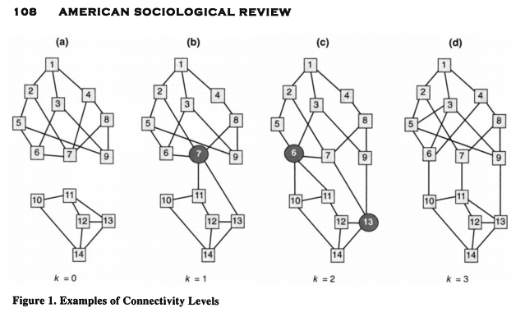
Graph Theory: K-connectivity
A graph with a minimal cutset of size k, is said to be k-connected
  The k-connectivity of any two vertices {u, v} in graph G, is the number of vertices that must be removed to disconnect u and v
  Thus, if it takes removing three vertices to disconnect two vertices, u and v are said to be three-connected.

Slide 30
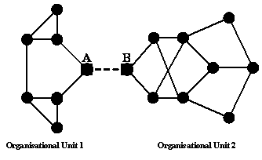
Graph Theory: Edge-connectivity
A bridge is an edge uv in graph G whose removal would disconnect the graph
The edge cut is the set of edges E' whose removal would disconnect the graph
  The edge cut for a pair of vertices u, v is defined in the same way
  The minimal edge cut is the smallest number of edges m whose removal would disconnect the graph
  The edge connectivity of a graph is the size of the minimal edge cut

Slide 31

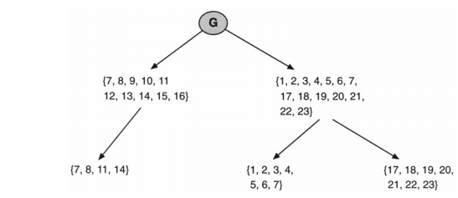
Cohesive Blocking
These are the bases of Moody and Whites Cohesive Blocking approach for the identification of nested cohesive subgroups:
  Identify the k-connectivity of the input graph
  Remove the k-cutset (vertices)
  Do the same on the resulting subgraphs until no more subdivisions can be obtained

Slide 32
(Literally) The Cutting Edge: Edge Clustering
Key disadvantage of most group detection approaches:
  Produce strict partitioning of vertices into mutually exclusive groups
  Consistent with some sociological understandings of groups
    “Community” (Tonnies)
  But also clashes with fundamental sociological idea that people in modern societies belong to multiple cross-cutting, overlapping groups
    “Society” (Durkheim, Tonnies, Simmel, Blau)
Need approach that allows for multiple group memberships
  Ahn et al (2010) provide a (clustering + optimization) based solution:
    Cluster edges not nodes!
    Because nodes are represented multiple times across edges a strict hierarchical clustering of edges results in a multiple assignment of nodes

Slide 33
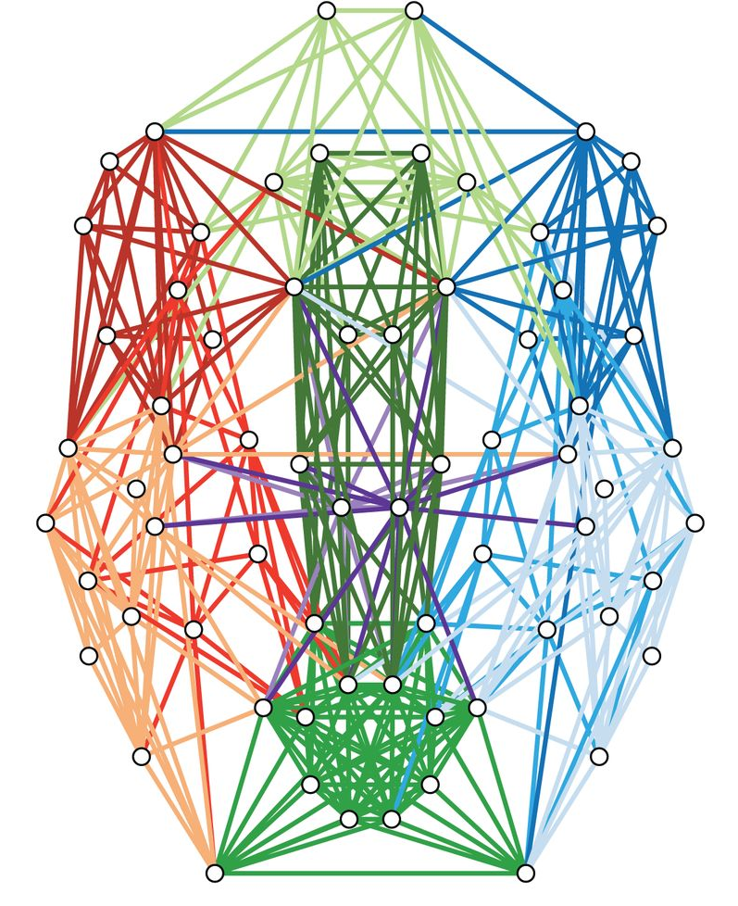
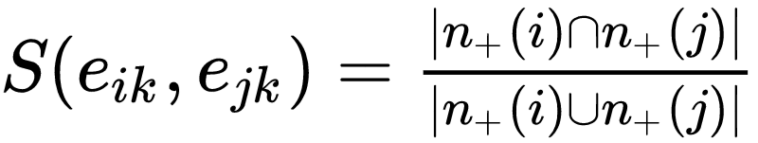
(Literally) The Cutting Edge: Edge Clustering
Procedure:
  Come up with an M x M (edge x edge) matrix based on an edge-similarity criterion:
  For instance for a pair of edges that share a vertex e_{ik} and e_{jk} similarity S may be defined as:
  Where n₊(i, j) is the set of neighbors of i and j
    This is the Jaccard similarity coefficient of the i, j vertices
  Apply single linkage hierarchical clustering to the result edge-similarity matrix

